Slide 1

Stock Price Forecasting Using Time Series and ML
Group 09 | Final ML Project
Machine Learning | Humber Polytechnical

Slide 2
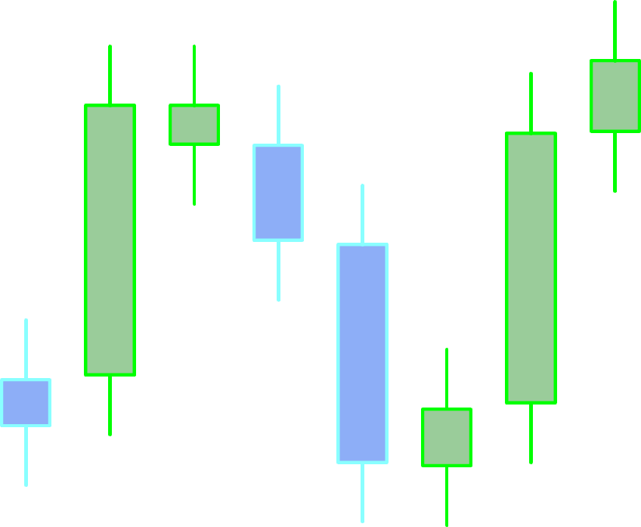

Team 09
ABHI THAKER | MOHIT RATHOD
AYUSHI ARORA | RUCHI TIWARI
BISHWAJIT DUTTA

Slide 3
Problem Statement
GOAL | Forecast Toronto-Dominion (TD) Bank stock prices using advanced time series and ML techniques
WHY | Helps in financial planning, risk analysis, and investment decisions
APPROACH | Integrate statistical models with deep learning in an interactive app

Slide 4
Dataset Overview
01
02
03
Source
Attributes
Handling
Yahoo Finance (TD stock, 2020–2025)
Date, Open, High, Low, Close (Daily, aggregated to Monthly)
Forward-filled missing values, outliers kept for real-world behavior

Slide 5
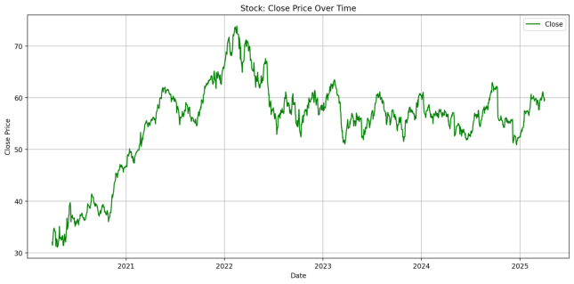
Key Insights from EDA
Upward trend from 2020 to early 2022
Impact of COVID & economic shocks visible
ADF test confirmed need for differencing
Seasonal trends: Investor activity spikes early in the year

Slide 6
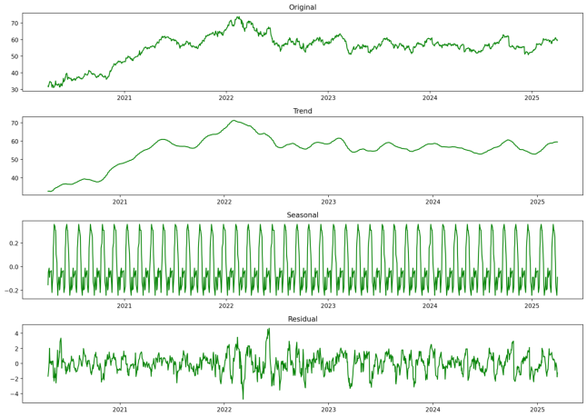
Time Series Decomposition
Trend
Seasonality
Additive & Multiplicative models separated into
Long-term price movement
Monthly investor behavior

Slide 7
Time Series Decomposition
Residual
Additive & Multiplicative models separated into
Market shocks
Additive model offered clearer interpretation

Slide 8
Forecasting Models Used
ARIMA
ETS
Strong for stationary series
Weighs recent data more
Prophet
LSTM
Captures holidays & trends
Deep learning model for sequential data

Slide 9
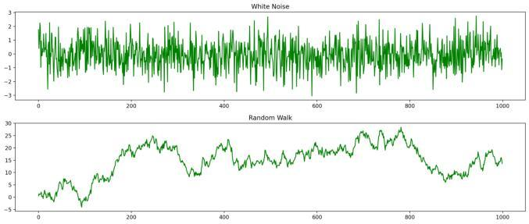
Simulated Series Analysis

Slide 10
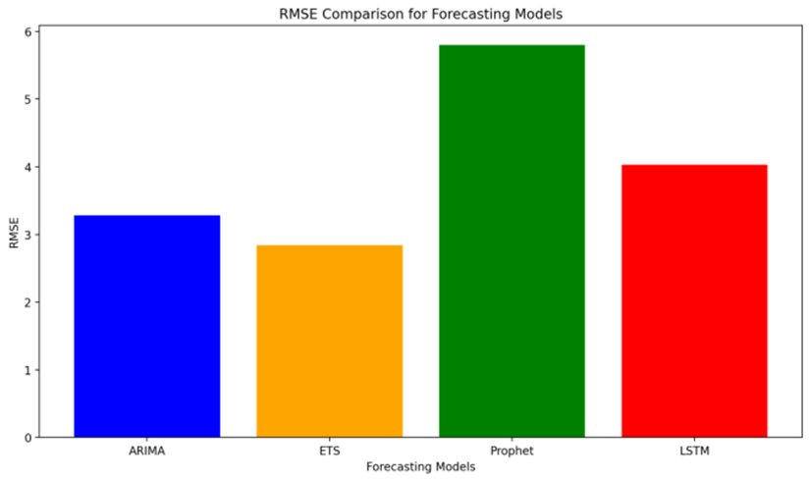
Model Performance Summary
Training/Test split
80:20
Best Model
ETS (highest accuracy)
Evaluation Metrics
RMSE, MAE, MAPE, MSE

Slide 11
Introducing the Streamlit App
Purpose: Make forecasting accessible & interactive
Hosted App: https://my-app-app-c4btndxjogwlseblgfzu9d.streamlit.app
Users: Analysts, students, traders, stakeholders

Slide 12

App Demo Walkthrough
Upload your CSV time series
Compare model performance by metrics
View predicted v/s actual
Visualize raw data
Select forecasting model
Choose decomposition type (Additive/ Multiplicative)
Check stationarity (ADF Test)

Slide 13
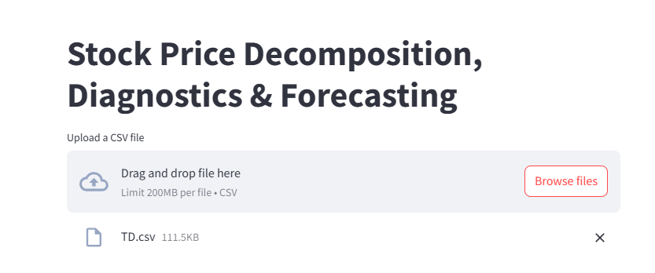
Live Interaction Example
Upload TD stock CSV

Slide 14
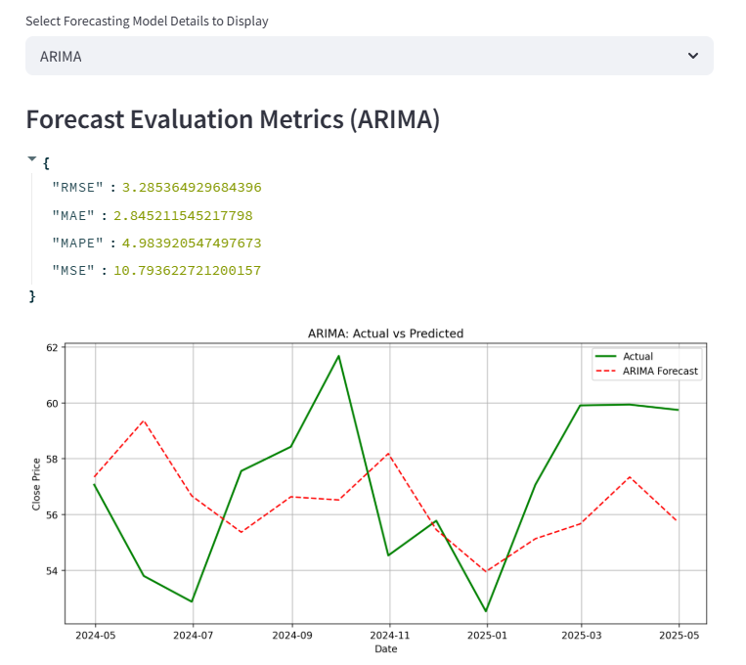
Live Interaction Example
Upload TD stock CSV
Select Model
View predicted and actual values

Slide 15
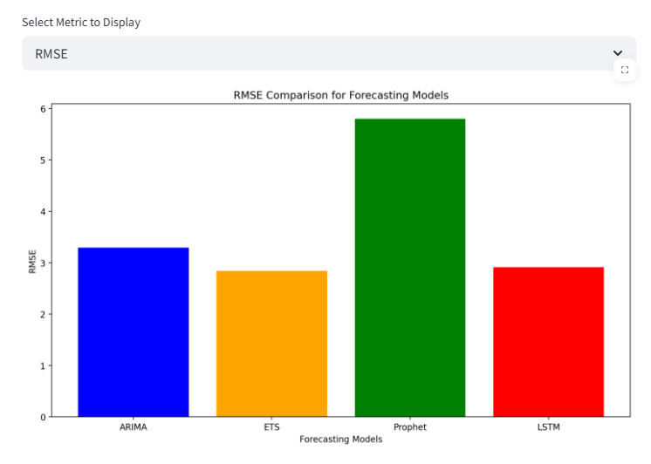
Live Interaction Example
Upload TD stock CSV
Select Model
View predicted and actual values
Select metric for comparison across model

Slide 16
User Interaction & Value
No coding required
Full transparency at each step
Valuable for finance teams, educators, and business users
Cloud-hosted: No setup needed

Slide 17
Conclusion & Takeaways
Integrated traditional & ML models
Demonstrated clear seasonal patterns & market trends
EST leads in accuracy, Prophet aids in long-term trends
Streamlit app brings the project to life for everyone

